Slide 1
JAVA Programming

Slide 2
TOPICs to be discussed
Set Interface
SortedSet Interface
Map Interface
SortedMap Interface
HashSet
LinkedHashSet
TreeSet
HashMap
LinkedHashMap
TreeMap

Slide 3

Let’s START …!!!

Slide 4
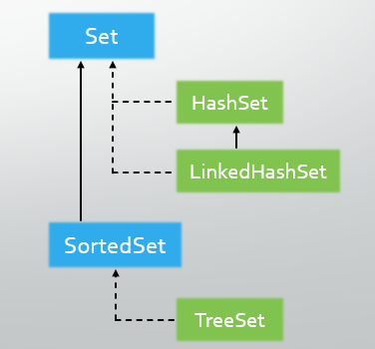
Set Interface
The Set interface represents a collection of unique elements (no duplicates).
It is part of the java.util package.
It allows at most one null element (depending on the implementation).
Implementation
HashSet
LinkedHashSet
TreeSet (implements SortedSet interface that extends Set Interface)

Slide 5
HashSet
The HashSet class in Java is a part of the Java Collection Framework, implementing the Set interface.
It is one of the most used implementations of the Set interface.
Key Features of HashSet
Uses hashing for storage, making add(), remove(), and contains() operations O(1) on average.
Does not maintain the order of elements.
Allows a single null element.
Not synchronized. If thread safety is needed, use Collections.synchronizedSet().

Slide 6
HashSet (Example)
import java.util.HashSet;
class HashSetDemo {
public static void main(String[] args) {
HashSet<String> hashSet = new HashSet<>();
//Adding elements to the HashSet
hashSet.add("Apple"); hashSet.add("Banana");
hashSet.add("Cherry");
hashSet.add("Apple"); //Duplicate, will not be added
//Checking for an element
System.out.println("Contains 'Banana': " +
hashSet.contains("Banana"));
//Iterating through the HashSet
for (String item : hashSet)
System.out.println(item);
//Removing an element
hashSet.remove("Cherry");
System.out.println("After removal: " + hashSet);
//Checking size
System.out.println("Size: " + hashSet.size());
}
}
Output:
Contains 'Banana': true
Apple
Cherry
Banana
After removal: [Apple, Banana]
Size: 2
Note: The order of elements while printing can be anything, as it is not maintained in HashSets

Slide 7
LinkedHashSet
The LinkedHashSet class in Java is a part of the java.util package.
It extends HashSet and implements the Set interface, maintaining the insertion order of elements. This makes it different from HashSet, which does not guarantee any specific order.
Key Features of LinkedHashSet
Internally, it uses a combination of a hash table (for fast operations like add(), remove(), contains()) and a linked list (to maintain the order).
Allows a single null element.
Like HashSet, it is not thread-synchronized. Requires external synchronization for concurrent access using Collections.synchronizedSet().

Slide 8
LinkedHashSet (Example)
import java.util.LinkedHashSet;
class LinkedHashSetDemo {
public static void main(String[] args) {
LinkedHashSet<String> linkedHashSet =
new LinkedHashSet<>();
//Adding elements to the HashSet
linkedHashSet.add("Apple");
linkedHashSet.add("Banana");
linkedHashSet.add("Cherry");
linkedHashSet.add("Apple"); //Duplicate, will not be added
//Checking for an element
System.out.println("Contains 'Banana': " +
linkedHashSet.contains("Banana"));
//Iterating through the HashSet
for (String item : linkedHashSet)
System.out.println(item);
//Removing an element
linkedHashSet.remove("Cherry");
System.out.println("After removal: " + linkedHashSet);
//Checking size
System.out.println("Size: " + linkedHashSet.size());
}
}
Output:
Contains 'Banana': true
Apple
Banana
Cherry
After removal: [Apple, Banana]
Size: 2
Note: The order of elements while printing is maintained in LinkedHashSets as the order of insertion of the elements

Slide 9
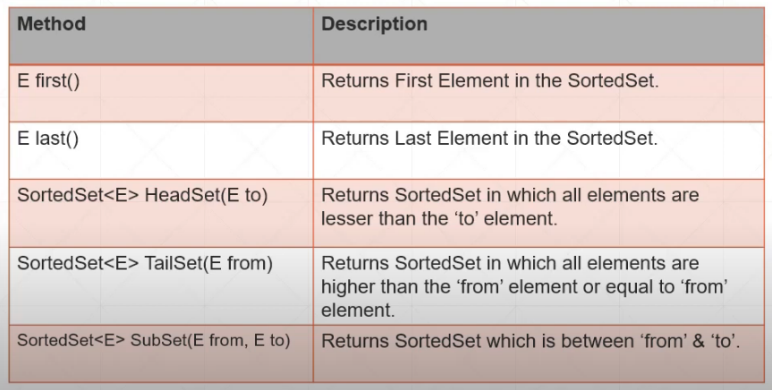
SortedSet Interface
The SortedSet interface is part of the java.util package in Java.
It extends the Set interface and represents a collection of unique elements that are maintained in sorted order.
Sorting can be based on the natural order of the elements (if they implement Comparable) or a custom order defined by a Comparator.
Implementation
TreeSet
ConcurrentSkipListSet

Slide 10
TreeSet
The TreeSet class in Java is part of the java.util package and implements the SortedSet and NavigableSet interfaces.
It is a collection that maintains unique elements in sorted order. Internally, it uses a red-black tree, which is a self-balancing binary search tree, to store elements.
Key Features of TreeSet
Operations like add(), remove(), and contains() take O(log n) time due to the underlying red-black tree.
Elements are stored in ascending order by default. A custom Comparator can be used for user-defined sorting. (e.g., Comparator.reverseOrder() in param. constructor)
does not allow null elements (else would have thrown NullPointerException).
Not synchronized. For thread safety (if needed), use Collections.synchronizedSet().
Provides methods for navigation like higher(), lower(), ceiling(), floor(), and range views like subSet(), headSet(), and tailSet().

Slide 11
TreeSet (Example)
import java.util.TreeSet;
class TreeSetDemo {
public static void main(String[] args) {
//Creating a TreeSet
TreeSet<Integer> treeSet = new TreeSet<>();
//Adding elements
treeSet.add(50); treeSet.add(20);
treeSet.add(30); treeSet.add(10);
//Displaying elements (sorted order)
System.out.println("TreeSet: " + treeSet);
//Accessing first and last elements
System.out.println("First: " + treeSet.first());
System.out.println("Last: " + treeSet.last());
//Subsets
System.out.println("less than 30: " + treeSet.headSet(30));
System.out.println("30 or greater: " + treeSet.tailSet(30));
System.out.println("20 to 50: " + treeSet.subSet(20, 50));
//Navigable methods
System.out.println("Ceiling of 20: " + treeSet.ceiling(20));
System.out.println("Floor of 20: " + treeSet.floor(20));
System.out.println("Higher than 20: " + treeSet.higher(20));
System.out.println("Lower than 20: " + treeSet.lower(20));
}
}
Output:
TreeSet: [10, 20, 30, 50]
First: 10
Last: 50
less than 30: [10, 20]
30 or greater: [30, 50]
20 to 50: [20, 30]
Ceiling of 20: 20
Floor of 20: 20
Higher than 20: 30
Lower than 20: 10

Slide 12
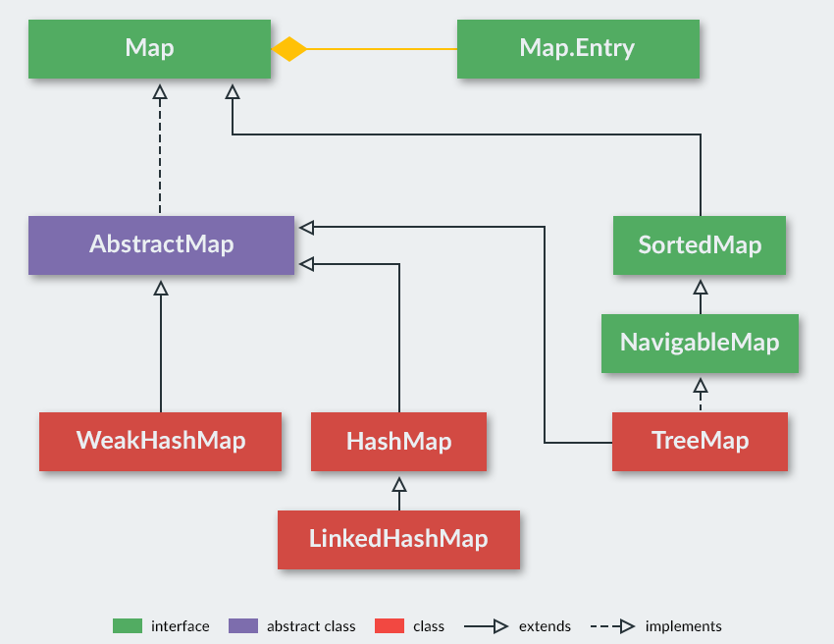
Map Interface
The Map interface in Java, part of the java.util package, represents a collection of key-value pairs.
It is designed for scenarios where data is stored and accessed using unique keys.
Unlike other collection interfaces such as List or Set, a Map is not a subtype of Collection.
Implementation
HashMap
LinkedHashMap
TreeMap (implements SortedMap interface that extends Map Interface)
WeakHashMap
ConcurrentHashMap

Slide 13
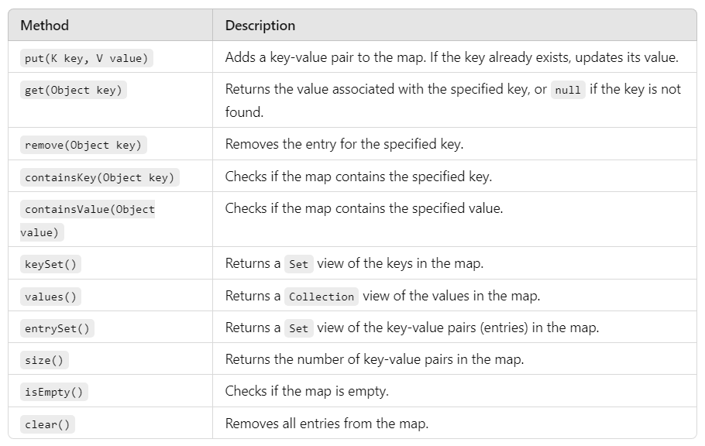
Map Features & Methods
Key Features of Map Interface
Each key maps to exactly one value. Keys must be unique, while values can be duplicated.
The order of keys and values is not guaranteed in a general Map. However, specific implementations like LinkedHashMap maintain insertion order, and TreeMap maintains sorted order based on keys.
Depending on the implementation, allows one (HashMap and LinkedHashMap) or no (TreeMap) null key and multiple null values.

Slide 14
HashMap
The HashMap class in Java, part of the java.util package, is a widely used implementation of the Map interface.
It provides a way to store and retrieve key-value pairs with efficient performance (O(1)).
Internally, it uses a hash table to store data.
import java.util.HashMap;
class HashMapDemo {
public static void main(String[] args) {
//Creating a HashMap
HashMap<String, Integer> map = new HashMap<>();
//Adding key-value pairs
map.put("Apple", 50); map.put("Banana", 20);
map.put("Cherry", 30); map.put("Orange", 70);
//Retrieving a value
System.out.println("Price of Apple: " + map.get("Apple"));
//Checking for a key
System.out.println("Contains 'Banana'? " + map.containsKey("Banana"));
//Iterating through the map
for(HashMap.Entry<String, Integer> entry : map.entrySet())
System.out.println(entry.getKey() + ": " + entry.getValue());
}
}
Output:
Price of Apple: 50
Contains 'Banana'? true
Apple: 50
Cherry: 30
Orange: 70
Banana: 20

Slide 15
LinkedHashMap
The LinkedHashMap class is a part of the java.util package.
It extends HashMap and implements the Map interface.
Unlike HashMap, it maintains the insertion order of its elements using a doubly-linked list running through its entries.
import java.util.LinkedHashMap;
class LinkedHashMapDemo {
public static void main(String[] args) {
//Creating a LinkedHashMap
LinkedHashMap<String, Integer> map = new LinkedHashMap<>();
//Adding key-value pairs
map.put("Apple", 50); map.put("Banana", 20);
map.put("Orange", 70); map.put("Cherry", 30);
//Retrieving a value
System.out.println("Price of Apple: " + map.get("Apple"));
//Checking for a key
System.out.println("Contains 'Banana'? " + map.containsKey("Banana"));
//Showing the Map
System.out.println(map);
}
}
Output:
Price of Apple: 50
Contains 'Banana'? true
{Apple=50, Banana=20, Orange=70, Cherry=30}

Slide 16
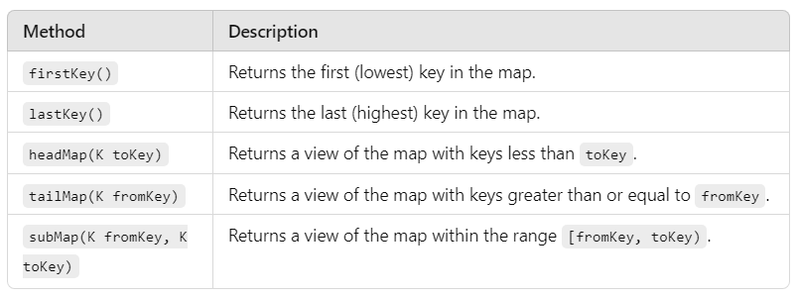
SortedMap Interface
The SortedMap interface is a part of the java.util package.
It is a specialized version of the Map interface that maintains its key-value pairs in sorted order.
The keys are sorted based on their natural ordering (if the keys implement Comparable) or by a specified Comparator.
Implementation
TreeMap
ConcurrentSkipListMap

Slide 17
TreeMap
The TreeMap class is the most commonly used implementation of the SortedMap interface.
It is a part of the java.util package and is based on a red-black tree (a self-balancing binary search tree).
Basic operations like put(), get(), remove(), and containsKey() have a time complexity of O(log n).
import java.util.TreeMap;
class TreeMapDemo {
public static void main(String[] args) {
//Creating a TreeMap
TreeMap<Integer, String> map = new TreeMap<>();
//Adding key-value pairs
map.put(10, "Ten"); map.put(20, "Twenty");
map.put(40, "Forty"); map.put(30, "Thirty");
//Printing the map
System.out.println(map);
//Subset view
System.out.println("SubMap(10 to 30): " + map.subMap(10, 30));
System.out.println("HeadMap(less than 30): " + map.headMap(30));
System.out.println("TailMap (30 and above): " + map.tailMap(30));
}
}
Output:
{10=Ten, 20=Twenty, 30=Thirty, 40=Forty}
SubMap(10 to 30): {10=Ten, 20=Twenty}
HeadMap(less than 30): {10=Ten, 20=Twenty}
TailMap (30 and above): {30=Thirty, 40=Forty}

Slide 18


